Slide 1

Chapter 3 – part II

Slide 2
OUTLINE
  Motion in a circle.
  Relative motion.
  Problems.

Slide 3
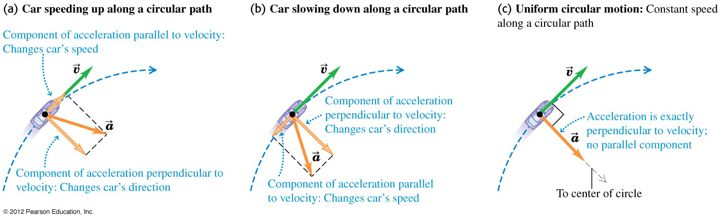
Uniform circular motion
For uniform circular motion, the speed is constant and the acceleration is perpendicular to the velocity.

Slide 4
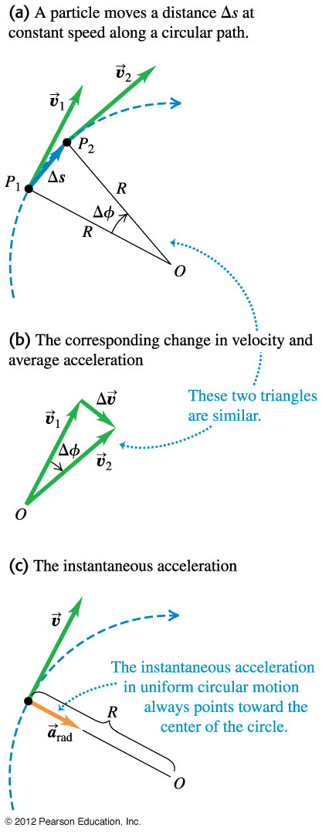
Acceleration for uniform circular motion
For uniform circular motion, the instantaneous acceleration always points toward the center of the circle and is called the centripetal acceleration.
The magnitude of the acceleration is a_{rad} = v²/R.
The period T is the time for one revolution, and a_{rad} = 4π²R/T².

Slide 5
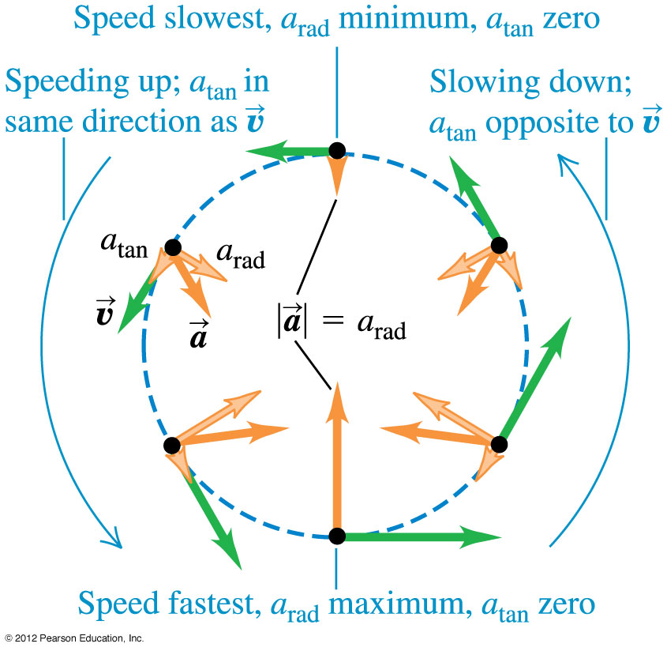
Nonuniform circular motion
If the speed varies, the motion is nonuniform circular motion.
The radial acceleration component is still a_{rad} = v²/R, but there is also a tangential acceleration component a_{tan} that is parallel to the instantaneous velocity.

Slide 6
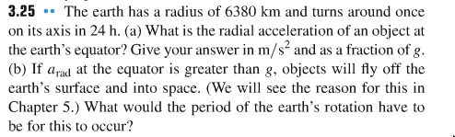
Problem #1

Slide 7
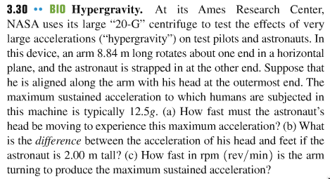
Problem #2

Slide 8
Relative velocity
  The velocity of a moving body seen by a particular observer is called the velocity relative to that observer, or simply the relative velocity.
  A frame of reference is a coordinate system plus a time scale.

Slide 9
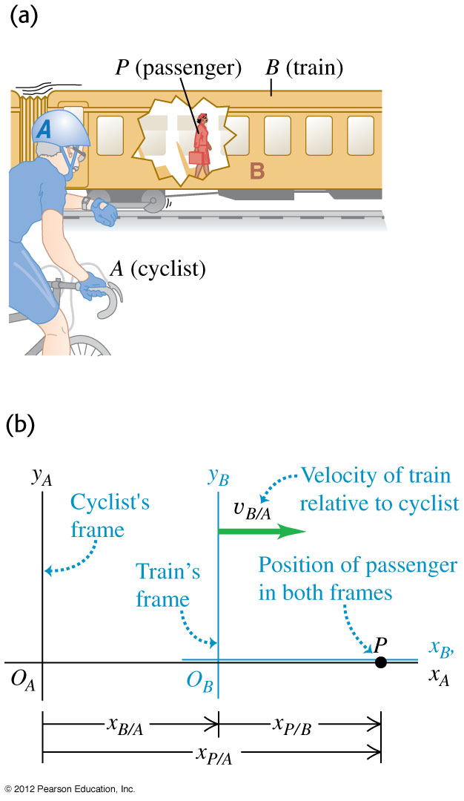
Relative velocity in one dimension
  If point P is moving relative to reference frame A, we denote the velocity of P relative to frame A as v_{P/A}.
  If P is moving relative to frame B and frame B is moving relative to frame A, then the x-velocity of P relative to frame A is v_{P/A-x} = v_{P/B-x} + v_{B/A-x}.

Slide 10
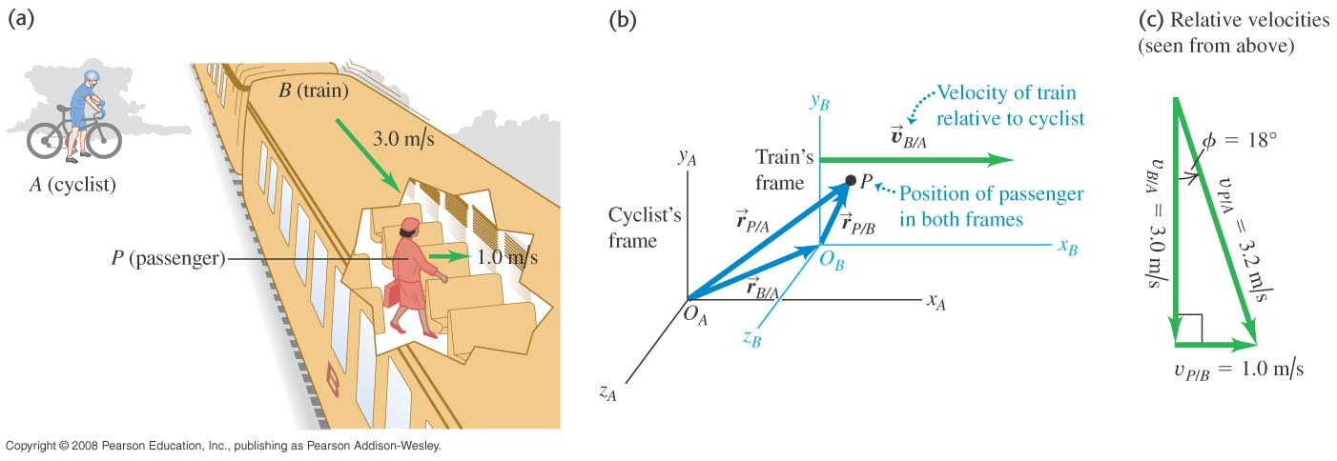
Relative velocity in two or three dimensions
We extend relative velocity to two or three dimensions by using vector addition to combine velocities.
In Figure, a passenger’s motion is viewed in the frame of the train and the cyclist.

Slide 11
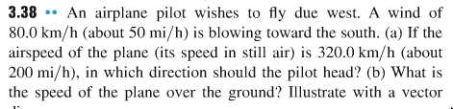
Problem #3

Slide 12
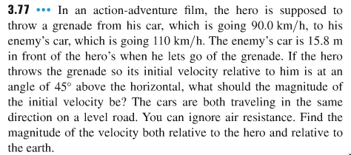
Problem #4

Slide 13
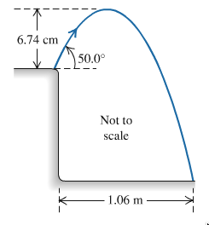
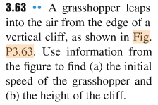
Problem #5

